Slide 1
Contra Project
Sprint 2 Presentation
Ethan Moore: ethan.moore416@topper.wku.edu
Aman Patel: aman.patel689@topper.wku.edu
Will Craddock: will.craddock123@topper.wku.edu

Slide 2
Project overview and goals
We are creating the Contra game.
Contra is a run and gun game created in 1987.
Theme of this game is humans fighting aliens.
Game has eight stages in the original version, two main characters and about ten different monsters/bosses.
Contra was published on few different platforms after the first success on arcade version.
Our goal is to create a game, maintain the documentation and other research materials we used for creating the game.

Slide 3
Non- Functional Requirements
We will use Unity game engine and development environment to create this game.
We will try to create complete replica of the game but fewer stages.
We will use pre-developed images, audio and some artwork from the original game.
We will be developing source codes for this project.
We will use database to store login information and scores of the players.
We will gather and optimize Performance metrics.
We will gather and optimize Security metrics.
We will gather and optimize User Interface metrics.

Slide 4
Functional requirements
Main character will be controlled by keyboard.
Users will be able to create multiple players and different accounts.
We will implement login systems for users and administrators.
Users will be able to save their progress once they log out and continue once they log back in. And progress will be displayed on the screen.
We will also create a splash screen which displays top scores and login prompt.

Slide 5
Approach to the project
We have played the game
All of us have experience in some aspect of creating this project.
Aman has experience in database and language and C#
Ethan has experience in Unity and C#.
Will has experience in Unity and database.
Group meets twice every week, and decided to meet outside of scheduled time if necessary.
We expect to spend 9 hours each member per week for this project.
Group meets with client once every week.

Slide 6
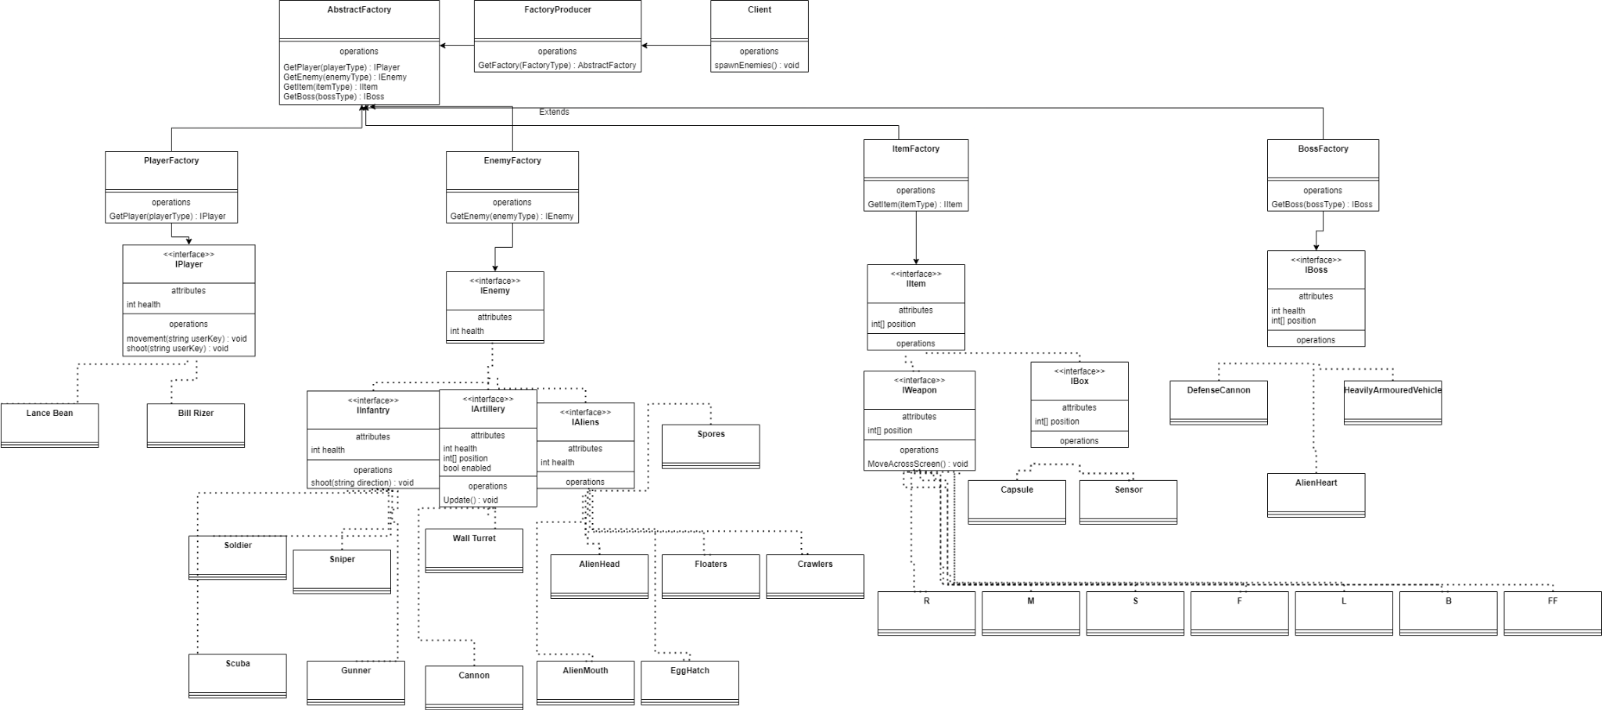
OO Design Patterns: Creational

Slide 7
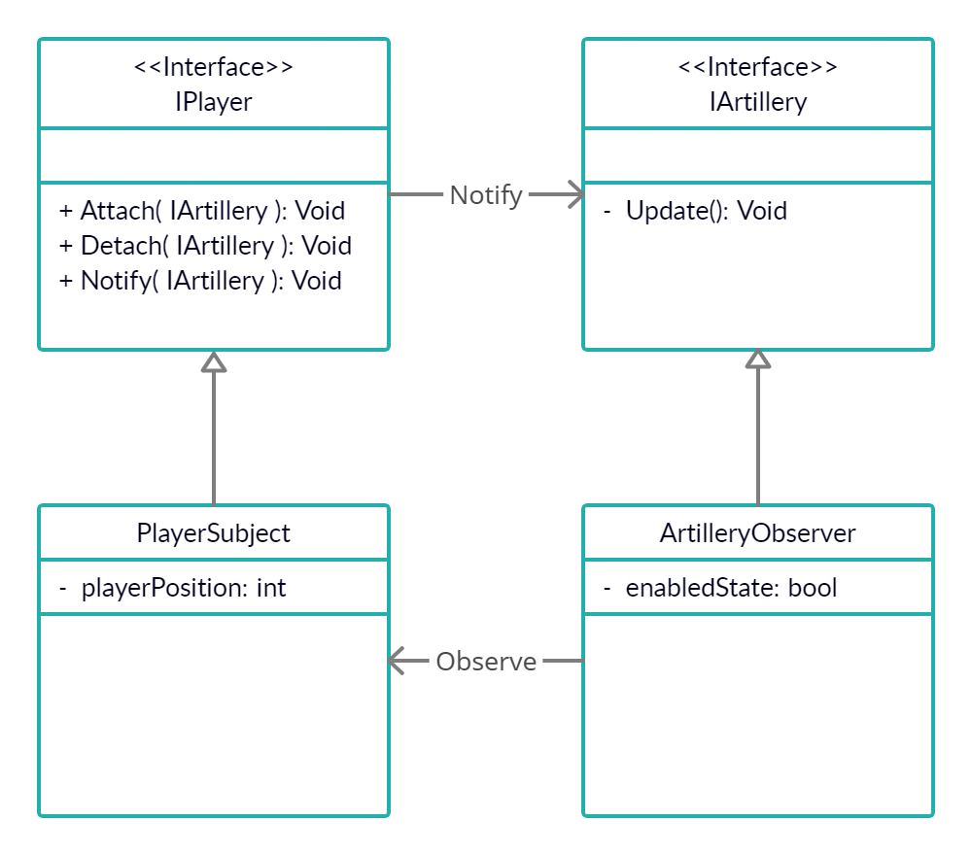
OO Designs: Behavioral

Slide 8
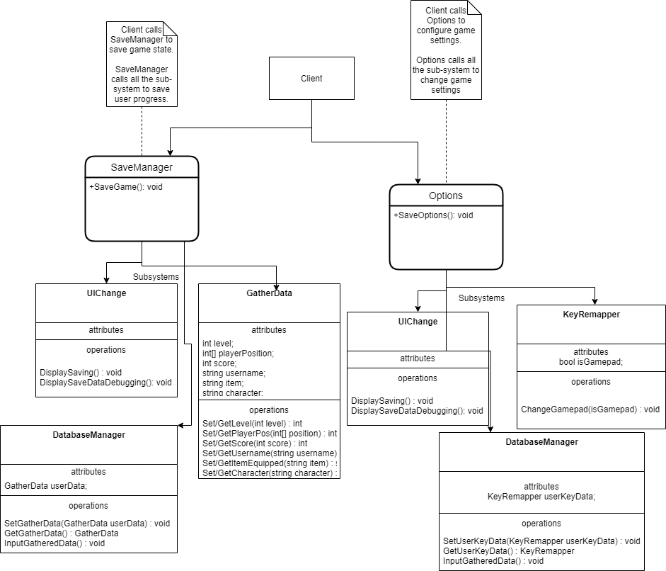
OO Designs: Structural

Slide 9
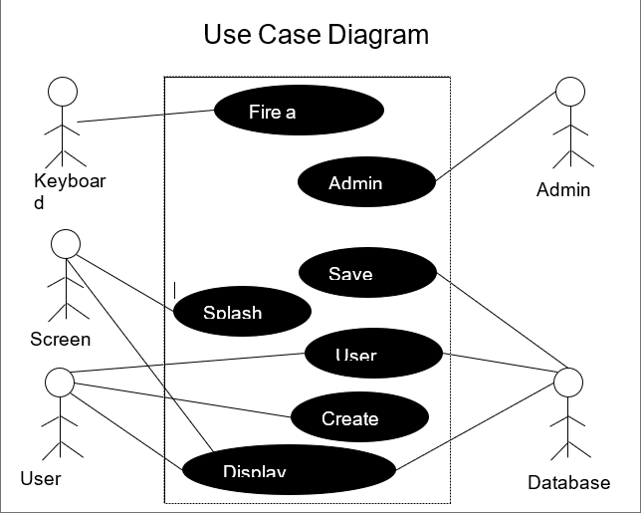
Behavioral UML Diagrams:Use Case Diagram and Scenarios

Slide 10
Use Case: Contra Game
ID: UC1
Actors: Player1, Player2, Database
Preconditions:
Primary Scenario: Splash Screen is displayed with the prompt to Login. Player logs in to the game Top score is displayed The player's top score and level the player is on. Player starts playing the game using the keyboard Another player joins the game. Creates a new account. And both players are playing a multiplayer game. Both users stops playing the game Their progress is saved in the database Both of them log out. First player logs back in and starts the game from where he left before.
Secondary Scenario: Error Logging in Invalid Hardware

Slide 11
Use Case: Contra Game
ID: UC2
Actors: Admin, Database
Preconditions: Player1 and Player2 Exists
Primary Scenario: Administrator login to his account Sees what all the players progress Sees Player 2 is not active for a while Deletes Player 2 Logs out of the account
Secondary Scenario: Error Logging in Invalid User

Slide 12
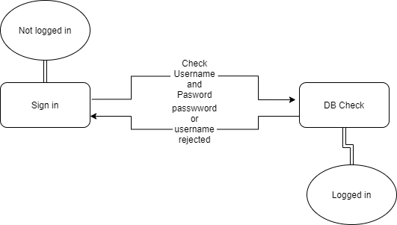

Behavioral UML Diagrams: State Diagrams

Slide 13
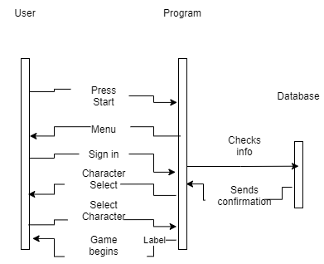
Behavioral UML Diagrams: Sequence

Slide 14
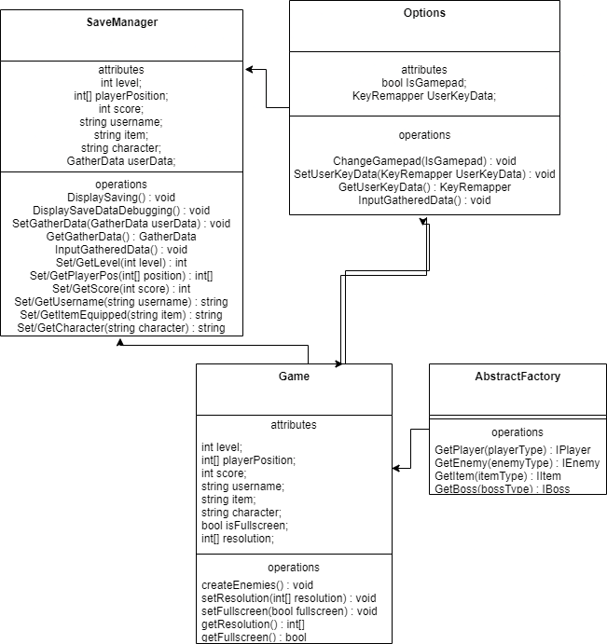
Structural UML Diagrams:Class diagrams

Slide 15
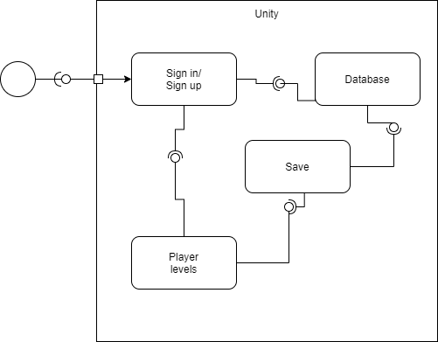
Structural UML Diagrams:Component diagrams

Slide 16
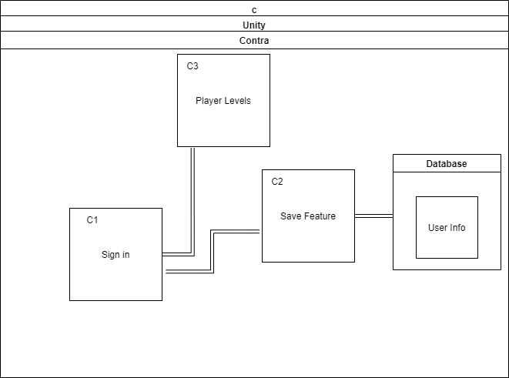
Structural UML Diagrams: Deployment Diagrams
p

Slide 17
System Boundaries: Logical/physical
Physical: We will be using windows laptop for implementing the contra game.
Players will need windows laptop for playing the game.
Specs for the laptop are,
Ram: 4 GB or more
Processor: 2.4 Ghz or faster
OS: Windows 7 or latest
Hard Disk: 16GB or more
Logical: We will be using unity game environment for developing the game.
All the objects and classes will be implemented according to the interface defined in the Unity support documentation.

Slide 18
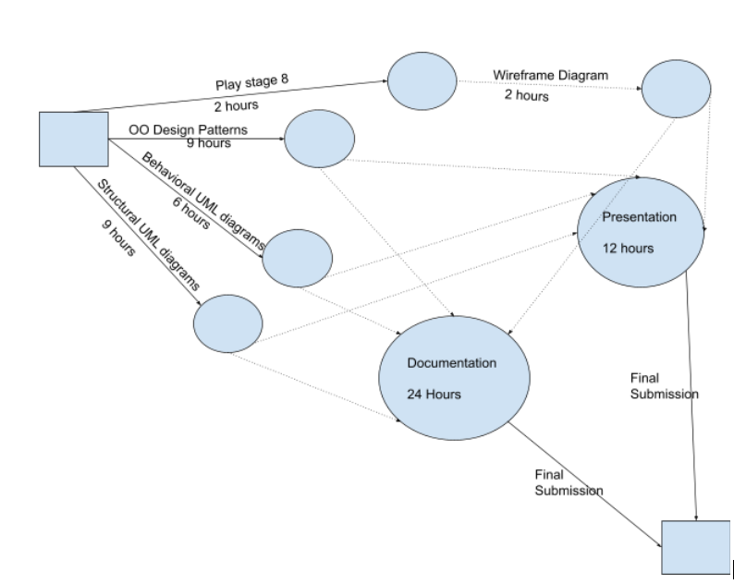
Activity Graph

Slide 19
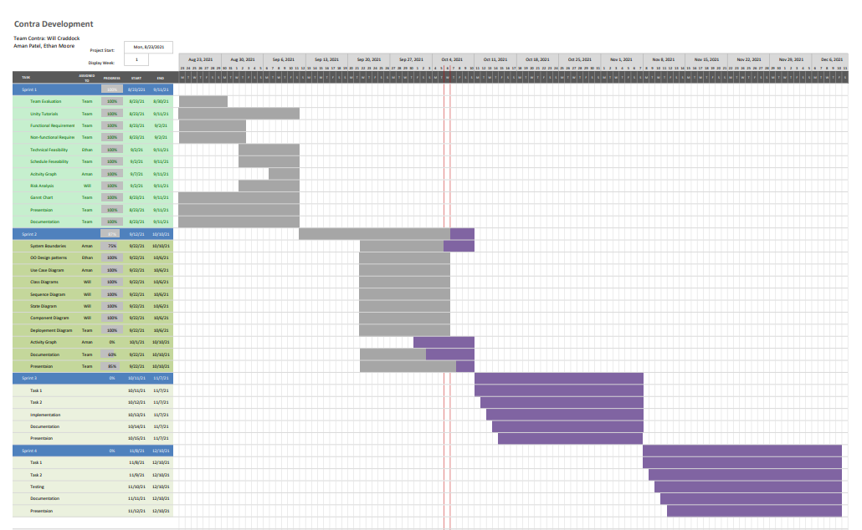

Slide 20
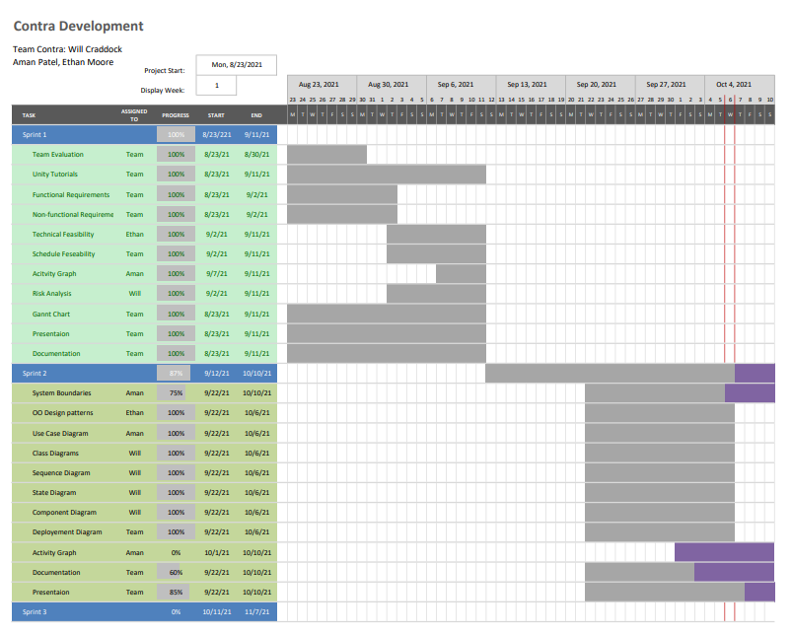

Slide 21
Risk analysis
Hardware malfunctions
Incompatible code/code malfunctions
Schedule availability
Physical health
Extreme weather
Unknown factors
Previous commitments
Person leaves the project

Slide 22
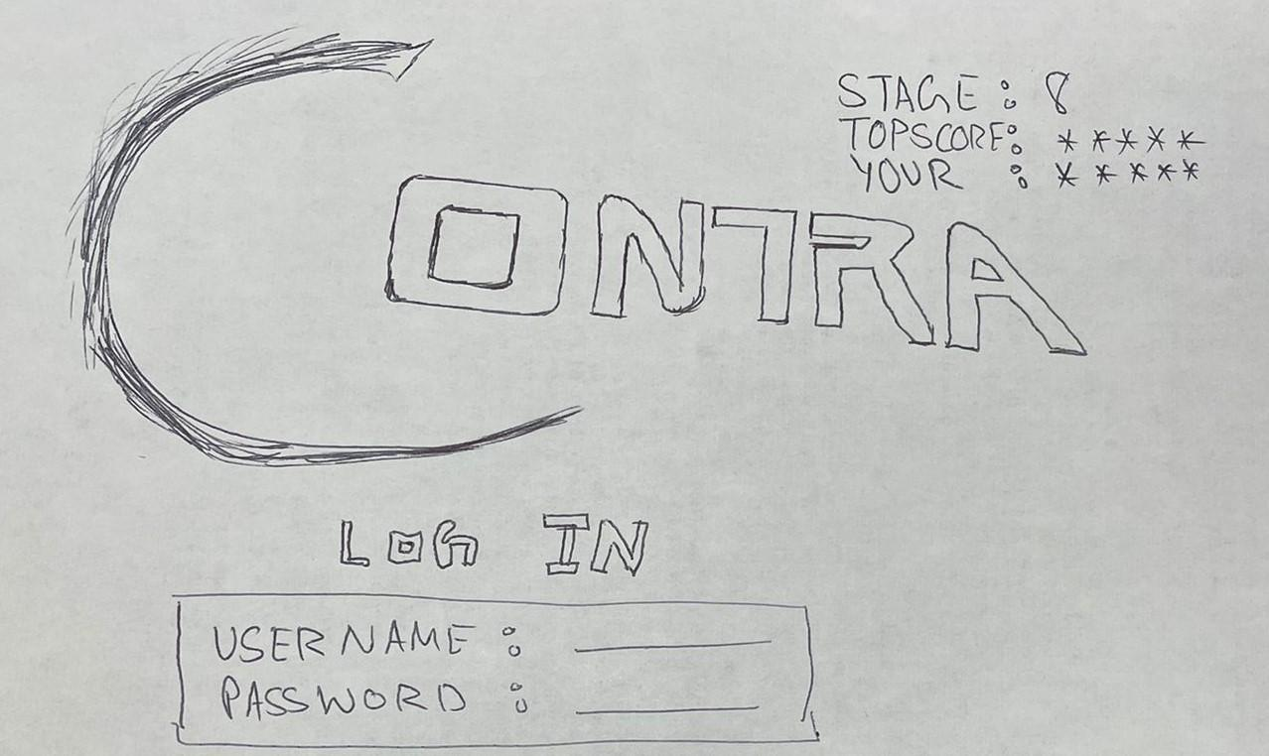
Splash Screen(Login)

Slide 23
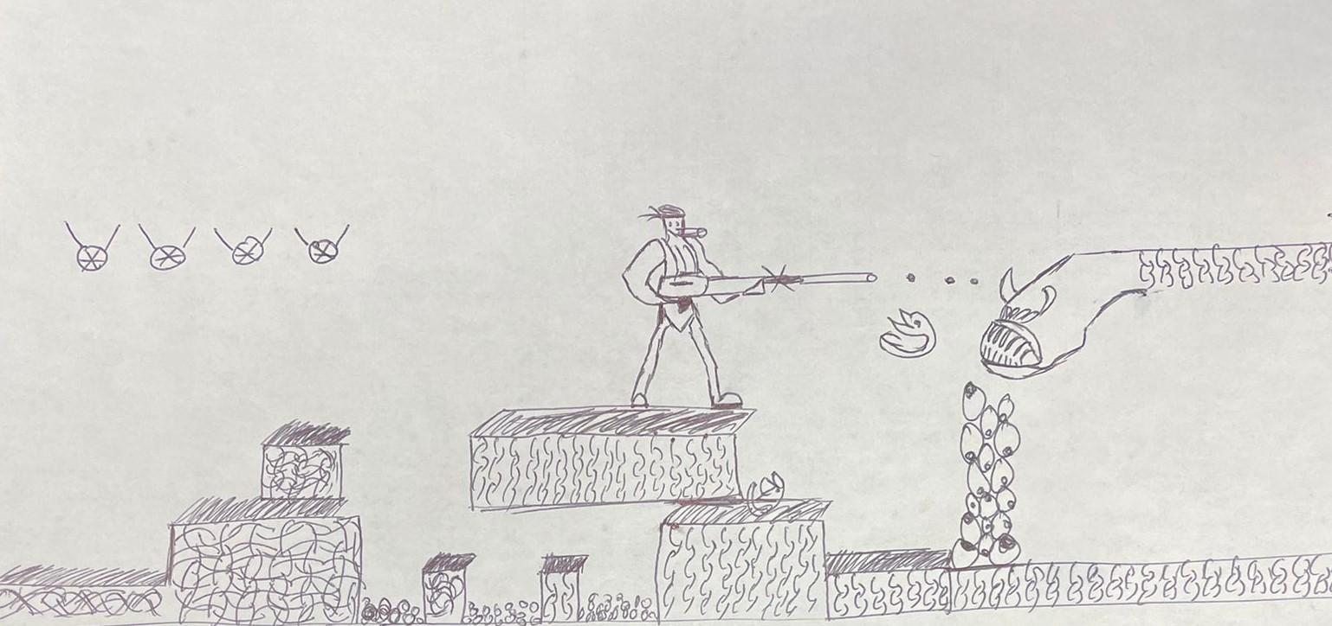
Gamplay

Slide 24
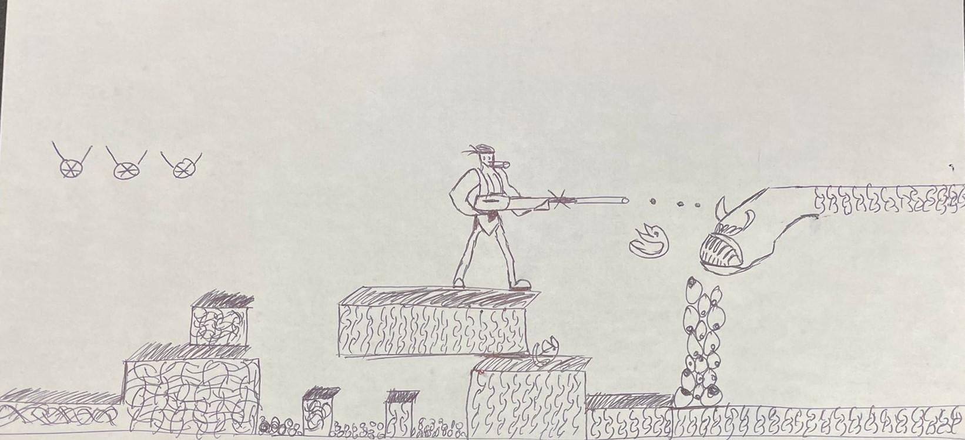
Gameplay

Slide 25
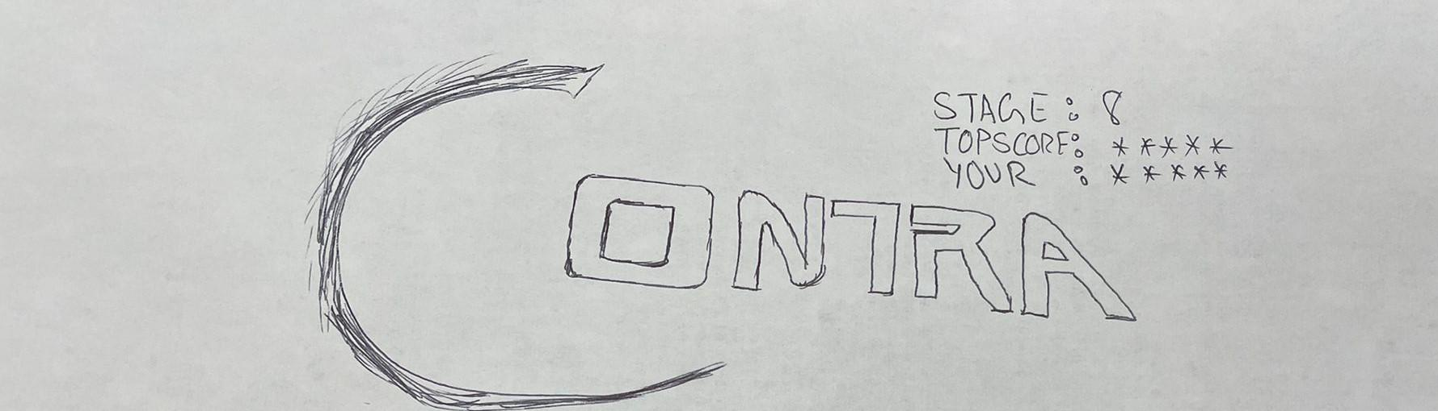

Splash Screen(Logout)

